Slide 1
Virtues & Values
and how they impel us to do good

Slide 2
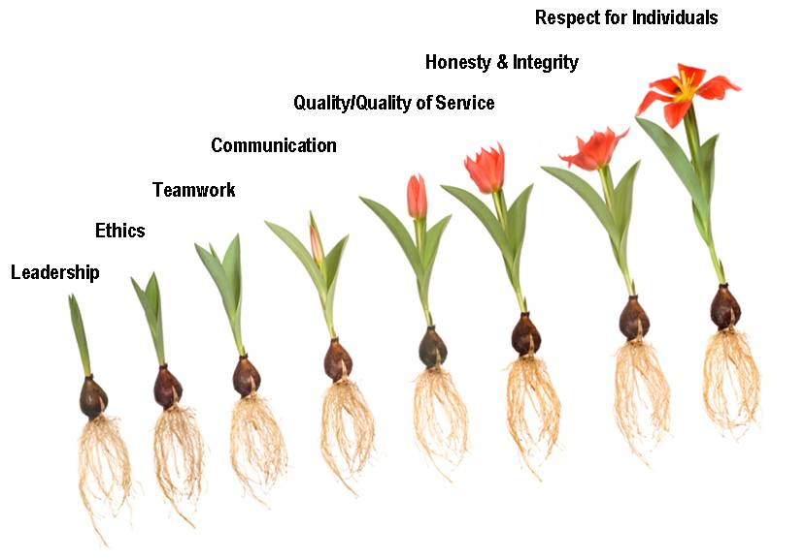
Societal values

Slide 3
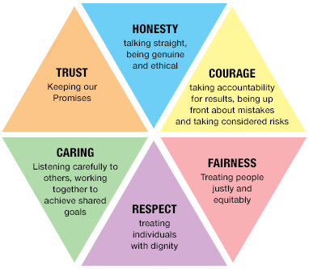
Societal values

Slide 4
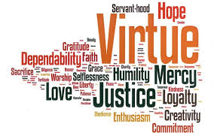
Let’s compare these with a more Christian approach

Slide 5
Theological virtues
Faith
Hope
Love

Slide 6
Cardinal virtues
Wise judgment/Prudence
Courage/Fortitude
Wholeness/Temperance

Slide 7
What kind of person do I want to become?

Slide 8
Scripture reflection
Learn to do good; seek justice, correct oppression; bring justice to the fatherless, plead the widow's cause.
Isaiah 1:17

Slide 9
How are we responsible for the development of our own moral character?

Slide 10
Scripture reflection
Religion that is pure and undefiled before God, the Father, is this: to visit orphans and widows in their affliction, and to keep oneself unstained from the world.
James 1:27

Slide 11
How do virtues & values motivate us into action?

Slide 12
Scripture reflection
So now faith, hope, and love abide, these three; but the greatest of these is love.
1 Corinthians 13:13

Slide 13
How do virtues & values guide us in the pursuit of moral maturity?

Slide 14
Scripture reflection
All Scripture is breathed out by God and profitable for teaching, for reproof, for correction, and for training in righteousness.
2 Timothy 3:16

Slide 15
Who am i? people who follow their conscience and act with conviction
He grew up in a tiny village and was the first member of his family to attend school.
He had a chance to get out of prison — and declined, on principle.
When he finally got out, he only strengthened his fight against Apartheid.
His policies saved and improved innumerable lives.
He used sports to bring the racially divided country together.
He was open about his biggest mistake — and tried till the end to make up for it.

Slide 16
ANSWER

Slide 17
Who am i? people who follow their conscience and act with conviction
Although she lived to be 87, she never saw her mother or sister again after the day she left for Ireland.
It took two years of preparation before she was able to begin doing the work she felt compelled to do.
She didn't have any equipment or supplies this time, but she taught her students to read and write by writing in the dirt with sticks.
She went on to open a hospice for the poor, a home for sufferers of leprosy, and a home for orphans and homeless youths.
She continued her work with the poor for the rest of her life, leading the Missionaries of Charity until just months before her death.

Slide 18
ANSWER

Slide 19
Who am i? people who follow their conscience and act with conviction
He skipped two grades in high school, 9th and 11th, and entered college (Moorehouse College) at the tender age of 15 in 1944. By 19, he received a bachelor’s degree in sociology.
To date the youngest male to win a Nobel Peace Prize, winning it in 1964 at the age of 35.
His house was once bombed, during the Montgomery Bus Boycott.
He was jailed 29 times.
He narrowly escaped an assassination attempt a decade before his death.

Slide 20
ANSWER

Slide 21
Who am i? people who follow their conscience and act with conviction
He was an accomplished lutenist, learning from his father.
In the last year of his life, when he was totally blind, he designed an escapement mechanism for a pendulum clock called __________’s escapement.
The middle finger of his right hand has been exhibited in Florence, Italy.
He claimed to have discovered sunspots and that the sun rotates.
His abrasive and outspoken criticism of Aristotelian philosophy and his obvious acceptance of the Copernican worldview, led him into serious trouble with the Roman Catholic Church.
The Roman Catholic Church, which placed him under house arrest for the last eight years of his life.

Slide 22
ANSWER

Slide 23
Who am i? people who follow their conscience and act with conviction
Around the age of 12 or 13, she apparently began hearing voices and experiencing visions, which she interpreted as signs from God.
During her trial, she testified that angels and saints first told her merely to attend church and live piously; later, they began instructing her to deliver France from the invading English and establish Charles VII, the uncrowned heir to the French throne, as the country’s rightful king.
She would accompany her army as a sort of inspirational mascot, brandishing her banner in place of a weapon.
She was burnt at the stake for the crime of heresy.

Slide 24
ANSWER

Slide 25
Who am i? people who follow their conscience and act with conviction
At 17 years old, she is the youngest recipient of the Nobel Peace Prize since its inception in 1901.
She addressed the United Nations on her 16th birthday.
She originally wanted to be a doctor.
She was shot on October 9th, 2012 and was reported to be in critical condition and not expected to survive.
As the global spokesperson for girls’ education, she has relentlessly advocated on behalf of her cause, continuing to speak out (despite increased Taliban threats).

Slide 26
ANSWER

Slide 27
In summary: people who follow their conscience and act with conviction…….

Slide 28
In summary: people who follow their conscience and act with conviction…….

Slide 29
How is Jesus a man who follows his conscience and acts with conviction?

Slide 30
Rights & Freedoms
Use the handouts supplied to address the following questions:
What are rights?
What are responsibilities?
What is freedom?
How does free will affect us?

Slide 31
What are rights?

Slide 32
What are responsibilities?

Slide 33
What is freedom?

Slide 34
How does free will affect us?

Slide 35
Rights & Freedoms
Activity
Complete the asylum simulation on the SBS website. http://www.sbs.com.au/goback/schools
Then answer the questions on the following slides.

Slide 36
questions
What decisions did you have to make during this simulation?

Slide 37
questions
Were you always comfortable with the decisions you made?

Slide 38
questions
How did the limit to your liberties affect the decision making process?

Slide 39
Rights & Freedoms
United Nations Declaration on Human Rights
https://www.youtube.com/watch?v=hTlrSYbCbHE
http://www.un.org/en/documents/udhr/index.shtml

Slide 40
Class activity
You will be given blank coloured cards. On each card there is a question/statement which links to one of the 10 Commandments or Beatitudes.
You are to then stick your responses to suit the correct Commandment or Beatitude placed around the room.
We will then discuss your findings

