Slide 1
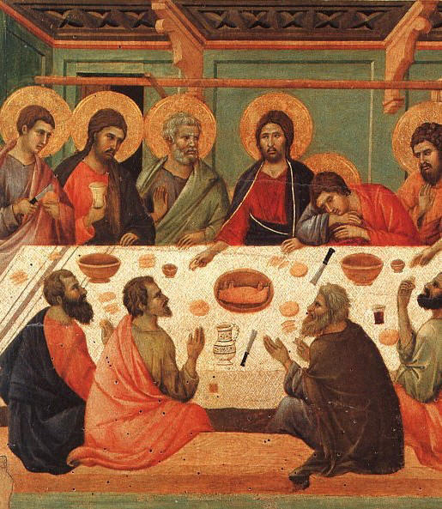
The History of the Eucharist
2000 Years of Celebration

Slide 2
Background
Like all sacraments changed over time
Table fellowship
established Jewish practice by the end of 1st Century.
Visitors share meal as sign of welcome
Part of families Sabbath devotional practice
Jesus ministry was often during meals
E.g. Feeding the 5000, Wedding at Cana, The Last Supper
Last Supper
Held on the first night of the Jewish Festival of the Passover
The Passover includes a series of ritual meals
Commencement of the sacrament of the Eucharist

Slide 3
What is ‘table fellowship’?
List 3 examples of Jesus teaching at meals?
On what day was the Last Supper held?

Slide 4
The Early Years – Sacred Meal and Sacrifice
Early Christians Gathered together on Saturday night[first day of the week] to ‘break bread’ after sunset
The Eucharist was often referred to as the ‘breaking of the bread’
Midnight began the communal meal or common supper agape, central component being the Eucharist, the consecration of the bread and wine
Meal is repeated weekly reflecting Jesus’ words “do this in memory of me”
Earliest celebration meals reflected the Last Supper and was shared in the homes of Jewish Christians
Study the Old Testament passages, share stories of Jesus life and teachings, pray and sing songs of praise
After about 150CE the common meal was no longer part of the ritual

Slide 5
Briefly describe how early Christians celebrated the Eucharist.
What does ‘breaking of the bread’ refer to and what does it mean?

Slide 6
2nd & 3rd Centuries
The Liturgy began to develop from the stories and teachings of the Early Christians, such as St Paul
Christians were no longer welcomed in synagogues they formed their own service including prayers, chanting, songs and the homily – this is recognised as the ‘development of the word’.
Early liturgical leaders had the freedom to compose their own prayers, however they were soon standardised, among the most famous is Hippolytus.
The liturgical language was Greek

Slide 7
What did the Jewish Christians add to the Eucharist after they were no longer welcome in synagogues?
Name a leader of the Christians who composed prayers?

Slide 8
4th & 5th Centuries
Emperor Constantine's toleration of Christianity around 313 CE assisted it rapid growth through the Roman Empire and massive changes to the celebration of the Eucharist
Latin became the language of the liturgy
Larger building called ‘basilicas’ to house more worshippers
Clergy grew in numbers and wear liturgical clothing
Meal symbolism faded with the emphasis placed on sacrificial
Fewer people received communion and less often as Christ divinity was stressed.
7th Century – Pope Gregory the Great declared that the Latin Mass of Roman was the standard for the western Church

Slide 9
What began to fade in the Liturgy and why?
What did Pope Gregory declare in the 7th Century?
Why did fewer people take communion?

Slide 10
9th – 15th Century – the Middle Ages
Focus on mass rather than communion
Christians took communion rarely emphasis was not on receiving but ‘adoring’ the Eucharistic Lord
Big churches and large communities
Consecration of the bread and wine was the high point of the liturgy
The wafer called the ‘host’ replaced bread
Transubstantiation was debated
Law passed 1215 forcing Catholics to receive the communion yearly

Slide 11
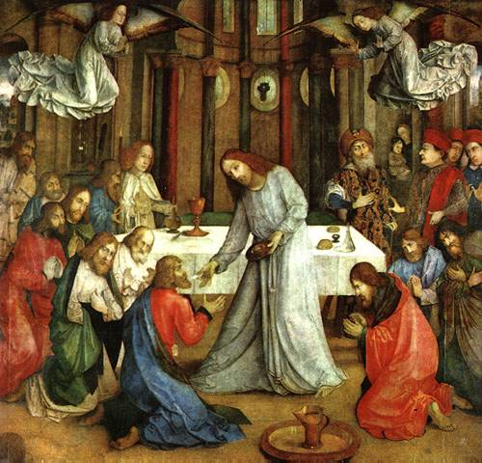
What does transubstantiation mean?
What law was passed in 1215 and why?
What replaced the bread in the liturgy?

Slide 12
Reformation to 20th Century
Council of Trent convened to repair abuses of the Church.
Reaffirmed the real presence of Christ in the Eucharist – body, bloody, spirituality and divinity
Defined transubstantiation – the change at consecration of bread and wine into body and blood of Christ
Nature of mass as sacrifice
Roman missal [used for the next 400 years]
People still tended to receive communion less frequently and sometimes outside mass. Pope Pius X in 1910 permitted the young to receive holy communion

Slide 13
What changes were made to the Eucharist due to the Council of Trent?
What did Pope Pius X Change and why?

Slide 14
The Eucharist Today
Vatican 2 – 1960s
Continued reform of the liturgies and sacraments
Mass in the vernacular language [local language]
Focus on liturgy
Homily based on readings
Alter faces the people
Inclusion of the Prayer s of the Faithful
Active congregational participation
Laity participation in mass
Eucharist is a celebration for the whole community

