Slide 1
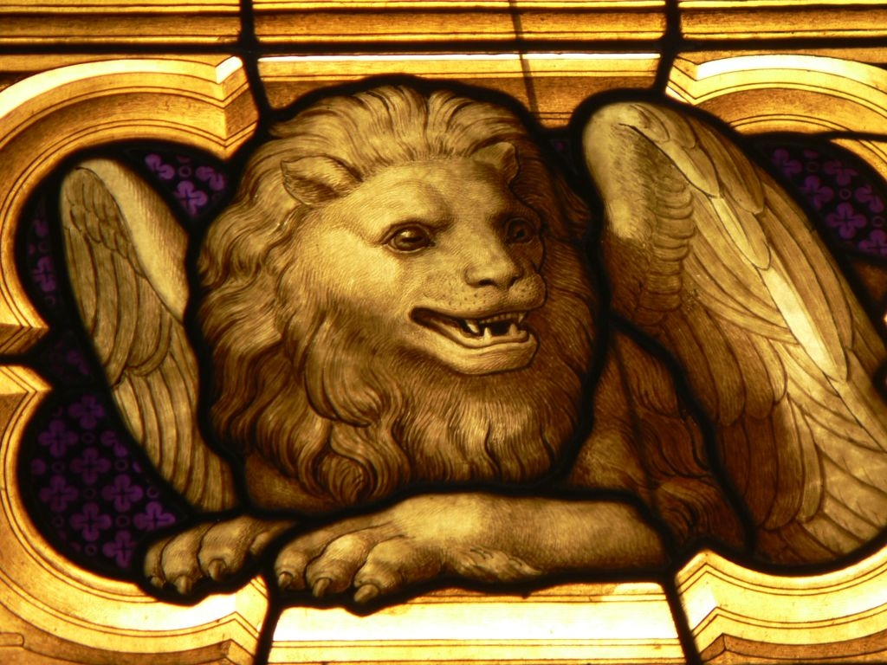
The Gospel of Mark
Year 10 Religion Mr Karam

Slide 2
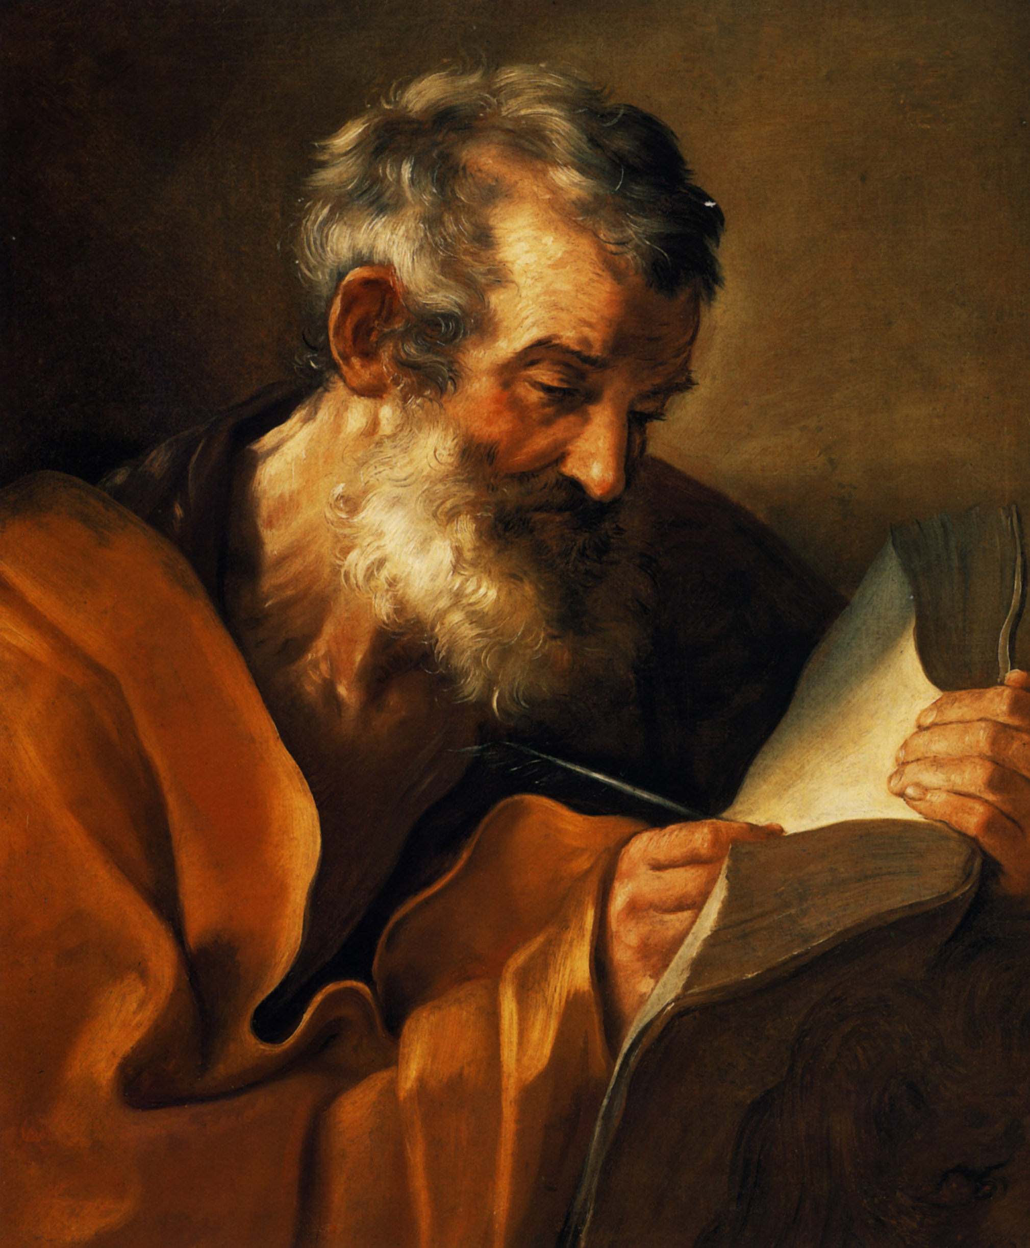
Author
Not certain on who is the exact author
Most early Church traditions trace it to John Mark a disciple of Peter
What we can say for certain is that the author was definitely writing for a community that may have known the influence of St Peter

Slide 3
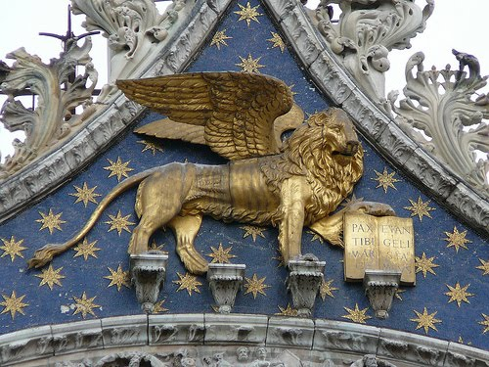
Interesting fact!
The evangelists are often symbolised by the following creatures:
Mark: Winged lion
Matthew: Winged man
Luke: Winged ox
John: Eagle
Some say he is depicted as a lion because he begins his Gospel in the wilderness or because he presents the Lord as the unconquerable King.

Slide 4
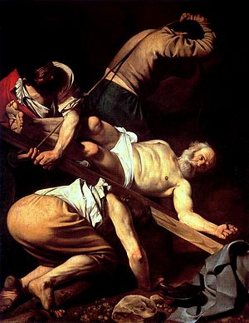
Date
Probably written between 65-70 AD
This was just after the crucifixion of St Peter
The year 70 AD was also the time of the destruction of Jerusalem by the Romans after a four year war
The mention of earthquakes and famine reinforce this date as these events were also recorded by the Roman Empire
The crucifixion of St Peter

Slide 5
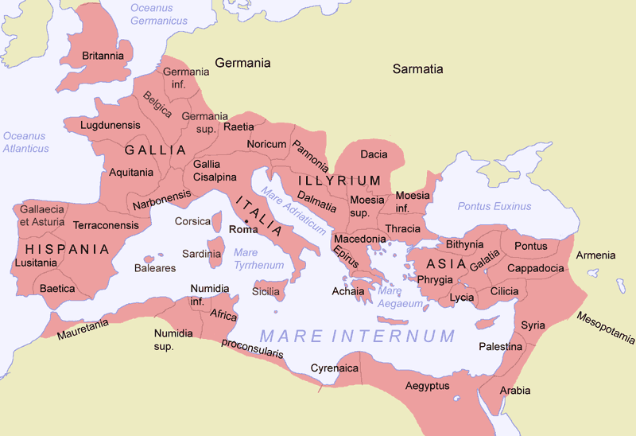
Place
Most likely written in Rome

Slide 6
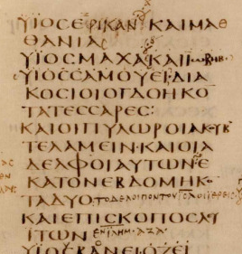
Intended Community
Written for a predominantly Gentile community
This Gospel has little concern with the Old Testament
He has to explain Jewish traditions in his writings
Contains many ‘Latinisms’ (more than any other gospel) so it can be assumed he is writing for a group of people who knew and used Latin.

Slide 7
Intended Community
This community was under threat (especially by Emperor Nero who killed two of their leaders by 67 AD).
They would have been distressed by the destruction of Jerusalem (the root of Christianity).
People worried that this was the end of time and Mark had to react against such pretenders.

Slide 8
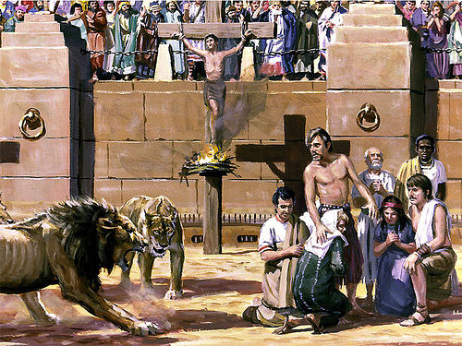
Can you remember?

Slide 9
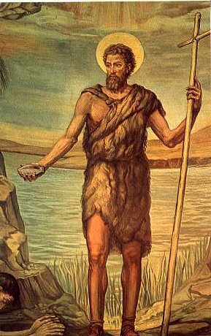
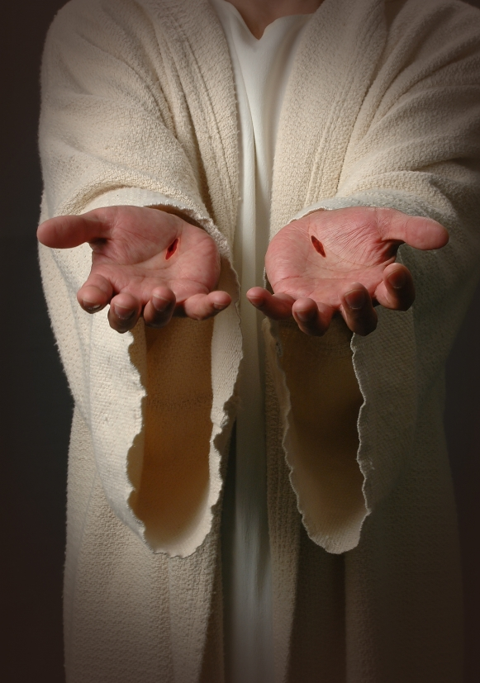
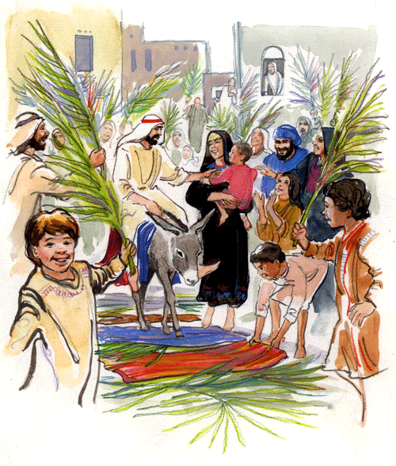
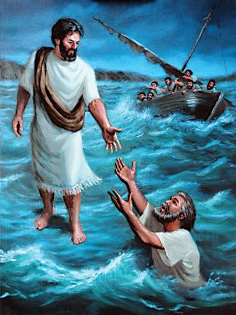
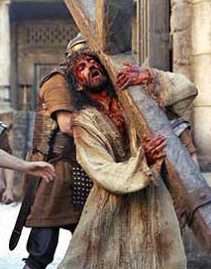
Structure

Slide 10
Style
Has been called ‘a Gospel in a hurry’
Also scattered with terms like “straightaway” or “at once”
Mark is an accomplished story teller with an eye for detail
Direct with an emotional impact
Uses colloquial (everyday) Greek
Uses repetition to emphasise a point

