Slide 1
Cosmetic Plastic Surgery
Choice or necessity?

Slide 2
Dove Evolution

Slide 3
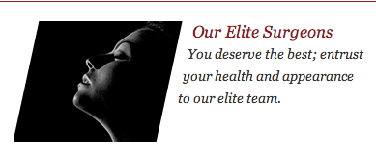
Teenage Plastic Surgery

Slide 4
Cosmetic Surgery
noun
"Plastic surgery for improving a person's appearance by restoration of damaged areas of skin, removal of wrinkles or blemishes, etc."
http://dictionary.reference.com/browse/cosmetic+surgery?s=t

Slide 5
Reconstructive Surgery
noun
"The restoration of appearance and function following injury or disease, or the correction of congenital defects, using the techniques of plastic surgery."
http://dictionary.reference.com/browse/reconstructive+surgery?s=t

Slide 6
COSMETIC AND RECONSTRUCTIVE SURGERY – FACTS AND MYTHS
FACT: "In Australia it is not illegal for a doctor without formal surgical training to
conduct cosmetic or plastic surgery if the patient agrees to the operation."
http://www.plasticsurgery.org.au/linkservid/D35CEB69-F4C9-487B-F1DB021984CAA62F/showMeta/0/

Slide 7
COSMETIC AND RECONSTRUCTIVE SURGERY – FACTS AND MYTHS
MYTH: "All plastic surgery procedures are performed in accredited facilities."
http://www.plasticsurgery.org.au/linkservid/D35CEB69-F4C9-487B-F1DB021984CAA62F/showMeta/0/

Slide 8
COSMETIC AND RECONSTRUCTIVE SURGERY – FACTS AND MYTHS
FACT: "All surgery, cosmetic and reconstructive, whether performed under local or general anaesthetic, in day surgery or in hospitals, can carry serious risk."
http://www.plasticsurgery.org.au/linkservid/D35CEB69-F4C9-487B-F1DB021984CAA62F/showMeta/0/

Slide 9
COSMETIC AND RECONSTRUCTIVE SURGERY – FACTS AND MYTHS
MYTH: "Plastic surgeons only perform reconstructive surgery."
http://www.plasticsurgery.org.au/linkservid/D35CEB69-F4C9-487B-F1DB021984CAA62F/showMeta/0/

Slide 10
COSMETIC AND RECONSTRUCTIVE SURGERY – FACTS AND MYTHS
FACT: "In Australia there is limited regulation or standardisation when it comes to the
use of titles to describe qualifications in the area of cosmetic surgery."
http://www.plasticsurgery.org.au/linkservid/D35CEB69-F4C9-487B-F1DB021984CAA62F/showMeta/0/

Slide 11
COSMETIC AND RECONSTRUCTIVE SURGERY – FACTS AND MYTHS
MYTH: "That cosmetic surgery advertising is highly regulated."
http://www.plasticsurgery.org.au/linkservid/D35CEB69-F4C9-487B-F1DB021984CAA62F/showMeta/0/

Slide 12
RISKS ASSOCIATED WITH COSMETIC SURGERY
• Unfavourable scarring
• Bleeding (hematoma)
• Infection
• Fluid accumulation
• Poor wound healing
• Skin loss
• Blood clots
• Numbness or other changes in skin sensation
• Anaesthesia risks

Slide 13
RISKS ASSOCIATED WITH COSMETIC SURGERY
• Skin discoloration and/or prolonged swelling
• Fatty tissue found deep in the skin might die (fat necrosis)
• Major wound separation
• Asymmetry
• Pain, which may persist
• Deep vein thrombosis, cardiac and pulmonary complications
• Possibility of revisional surgery
• Suboptimal aesthetic result

Slide 14
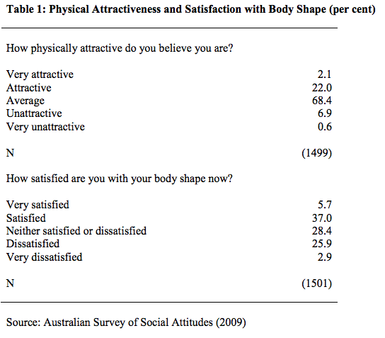
http://www.tasa.org.au/uploads/2008/12/Tranter-Bruce_-Hanson-Dallas.pdf

Slide 15
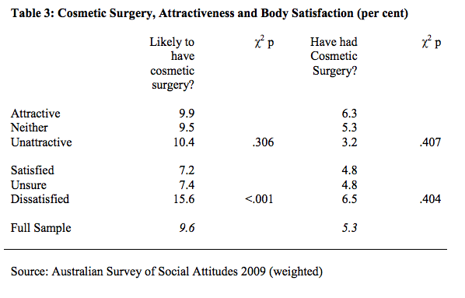
http://www.tasa.org.au/uploads/2008/12/Tranter-Bruce_-Hanson-Dallas.pdf

Slide 16
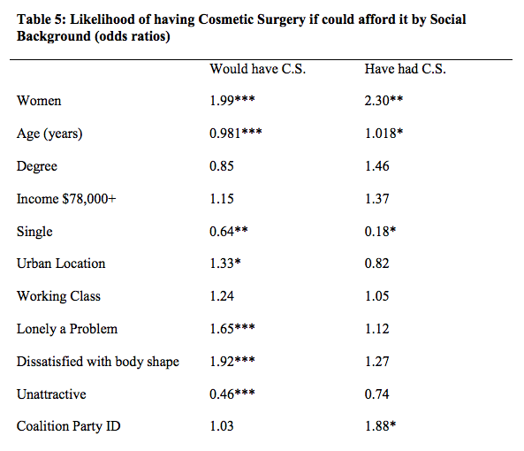
http://www.tasa.org.au/uploads/2008/12/Tranter-Bruce_-Hanson-Dallas.pdf

Slide 17
The Catholic Weekly
Fr John Fladder's reply to a question on the Church's stance on Cosmetic Surgery

Slide 18
Catholic Answers
Does the Church have a stand on plastic surgery?

Slide 19
Group questions (20 minute session)
How do the clips you have just viewed challenge or reaffirm what you believe about plastic surgery?
What moral responsibility do we have in our society on this issue?
Why do you feel teenagers are so susceptible to be influenced to have plastic surgery?
What Catholic key teachings help us make decisions on this issue?
Who can teenagers turn to for support on this issue?

Slide 20
Bibliography
Australian Society of Plastic Surgeons Media Resource Folder. Date Assessed 15.06.13. http://www.plasticsurgery.org.au/linkservid/D35CEB69-F4C9-487B-F1DB021984CAA62F/showMeta/0/
Catholic Answers. http://www.catholic.com/quickquestions/does-the-catholic-church-have-a-stand-was-on-plastic-surgery. Daet Accessed: 15.06.13
Dictionary.com. http://dictionary.reference.com/browse/cosmetic+surgery?s=t. Date Accessed 15.06.13
Dictionary.com. http://dictionary.reference.com/browse/reconstructive+surgery?s=t. Date Accessed 15.06.13
The Catholic Weekly. http://www.catholicweekly.com.au/article.php?classID=3&subclassID=59&articleID=9226&class=Features&subclass=Question%20Time. Date Accessed: 15.06.13
Tranter, B & Hanson, D. Cosmetic surgery, attraction and body image in Australia. University of Tasmania, 2009, 1-13.

Slide 21
Dove Real Body Sketches

