Slide 1
Personal Moral Responsibility

Slide 2
Socialisation
The way we learn about the correct way to behave in our own society, and the habits, customs, language and manners of our society is called socialisation.

Slide 3
Morality
Some of the ways we begin to discover what is right and what is wrong are by:
Consequence
Example
Experience
Emotions
Following the rules

Slide 4
Morality
Morality is concerned with what is right and wrong.
A moral act – an act considered to be right
An immoral act – an act considered to be wrong
An amoral – an act that shows no understanding of right or wrong
A non-moral act – an act not concerned with right or wrong
A non-moral judgement – a view or opinion that is nothing to do with right or wrong.

Slide 5
Types of Morality
Conflicting Morality | A strong support of environmental issues who doesn’t recycle.
The Right to Choose | Personal choice does not always equate with morality.
Everybody does it | Ignoring reality and the facts and following the crowd.
What’s wrong in nobody gets hurt | Ignoring the underlying repercussions of our decisions.
Christian Morality | Modelled on the teachings of Jesus Christ, the 10 Commandments and the Beatitudes.

Slide 6
Conscience
My responsibility for my actions, not necessarily my feelings but a thinking and choosing process.
If I am important as a person I need to live out the consequences or choices I make. I must be free to follow my own conscience – in fact I am obliged to follow my conscience once I have informed it.

Slide 7
Laws that may affect our conscience formation
Civil law
Moral Law
Natural Law
Divine Law
Church law

Slide 8
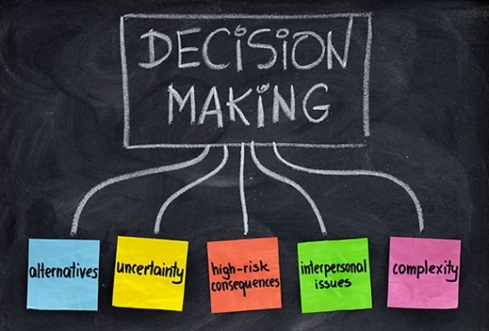
Steps in Decision Making

Slide 9
Step One
Define the Issue
What are the facts? (From all perspectives)

Slide 10
Step Two
Seek Advice
Family
Friends
Church Teachings
Moral Principles

Slide 11
Step Three
Reflect Honestly on the Consequences
What are my options?
If I do this then….

Slide 12
Step Four
Pray for God’s Guidance

Slide 13
Step Five
Weigh up the information and Act

Slide 14
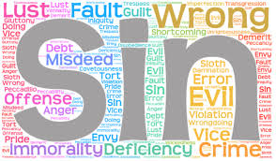
As an attitude
As an action
As a failure to act

Slide 15
The Scriptures & Sinfulness
Hebrew Scriptures | Christian Scriptures
Sin as rebellion against God
Sin as an ignoring of God | Sin as an injustice or a refusal of the love of God
Where God is understood as divine wisdom, sin is human foolishness | Sin as falsehood
Sin as an act of unfaithfulness, breaking the covenant | Sin as a form of darkness or blindness
Sin as a form of idolatry | Sin as temptation by the devil
Sin as rooted in human freedom: an abuse of free choice | Original sin

Slide 16
Social Sin
Refers to the sinful structures that are part of society and degrade and oppress people. Every social sin finds its origin in, and is brought about by, individual human sinful choices.
These are always initiated, supported and sustained by individuals
Examples include:
Discrimination and victimisation of minority groups
Corruption
Manipulation of Mass Media
Unjust war

Slide 17
Responsibility for Moral Choice
Degrees of Freedom
Case One: A bank teller who deliberately steals from his or her employer.
Case Two: A bank teller who hands over money to a thief who is threatening him or her.

Slide 18
Responsibility for Moral Choice
Degrees of Knowledge
Case One: A person who deliberately poisons their spouse to retrieve an insurance payout.
Case Two: A person who suffers from a mental illness and poisons their spouse without realising the implications of his or her actions.

Slide 19
Responsibility for Moral Choice
Degrees of Intention
Case One: A person accidentally runs over a child who dashes out from behind a car.
Case Two: A person deliberately rams into another car to injure the passengers.

Slide 20
Types of Sin
Venial Sin: an attitude or action that places tension or strain on our relationship with God and neighbour.
Serious Sin: an attitude or action, which dangerously strains our relationship with God and neighbour.
Mortal Sin: is an attitude or action that fully engages the person. The person not only fully chooses the attitude or action, but also chooses to be the kind of person who would perform the act.
Before sin can occur, therefore, the following conditions need to present:
Grave matter (seriousness of the act)
Full knowledge
Freedom and Consent

Slide 21
Degrees of Sinfulness
Using the list on the following table complete the following:
Part A: Rate the following list of sins in order of sinfulness (1 being the least).
Part B: Determine whether each sin is venial, serious or mortal.

Slide 22
Degrees of Sinfulness
 | Attempting to rob a bank , with the intention of stealing money. |  | Lying to your friend about where you were the other day when they wanted to catch up with you.
 | Stealing $5 from your mum’s purse. |  | Pretending to be sick to get out of doing something that would help your parents.
 | Threatening and bullying a Year 7 student in the playground. |  | Spreading rumours about one of your friends to get back at them.
 | Committing the act of murder. |  | Deliberately destroying a form of nature.
 | Witnessing an assault on a person and failing to come forward and assist the police with information about the offenders. |  | The lady at the canteen gave you too much change and you decide not to be honest and give it back to her.

Slide 23
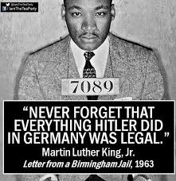
Let’s discuss

Slide 24
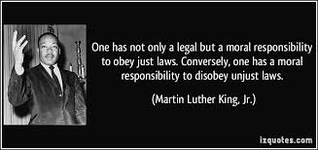
Let’s discuss

