Slide 1
Issues in Australian society
How can we support our nation?

Slide 2
What we actually see
What’s really happening in the world.

Slide 3
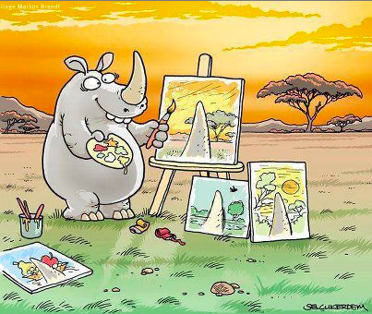
Let’s reflect on the image below

Slide 4
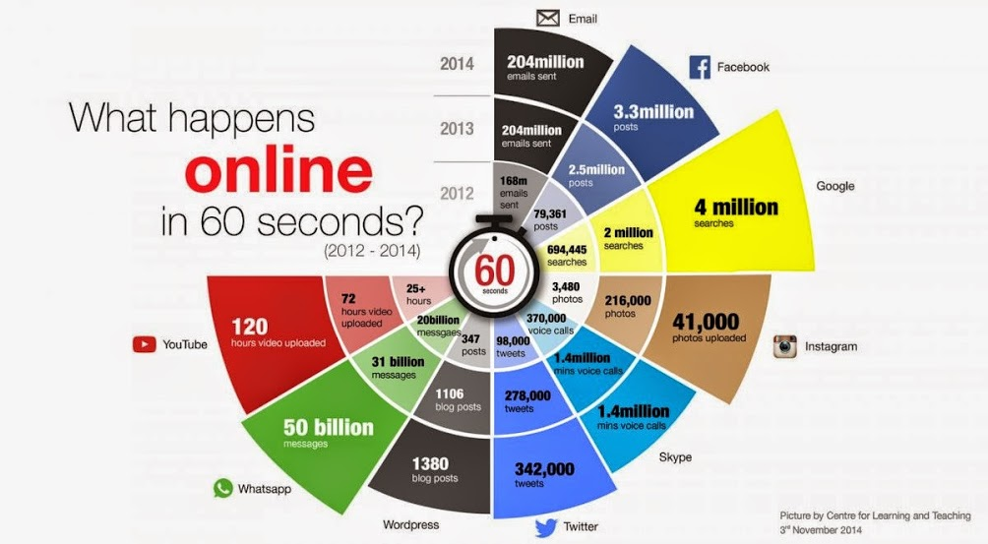
Let’s reflect on the image below

Slide 5
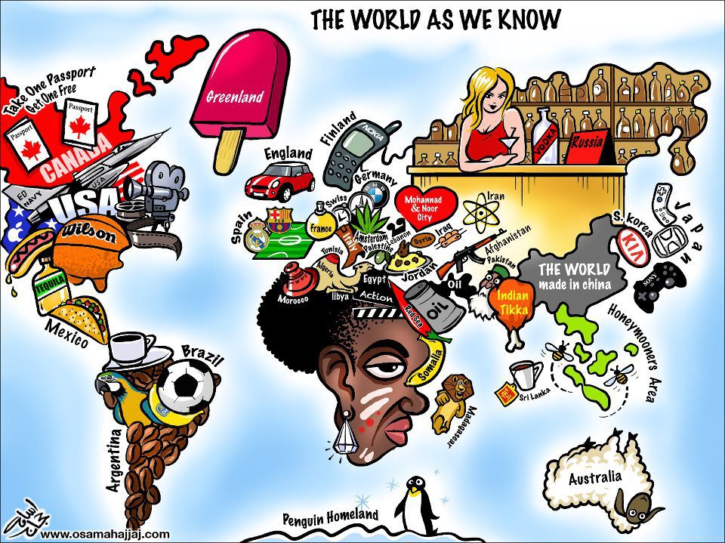
Let’s reflect on the image below

Slide 6
Issues in Australian society that are often overlooked
Each group will be appointed one of 15 issues on which to present a one page handout to the class outlining the facts.

Slide 7
Issues in Australian society
Suicide in women
Child Abuse & the Internet
Violence in families
http://suicidepreventionaust.org/wp-content/uploads/2015/07/Suicide-and-Suicidal-Behaviour-in-Women.pdf
https://aifs.gov.au/cfca/publications/child-abuse-and-internet
https://aifs.gov.au/publications/family-matters/issue-34/violence-families

Slide 8
Issues in Australian society
Ageing Population
Aboriginal Issues
Human Rights
https://www.adelaide.edu.au/apmrc/pubs/policy-briefs/APMRC_Policy_Brief_Vol_2_2.pdf
http://aiatsis.gov.au/publications/products/australian-aboriginal-studies-issue-1-2014
http://www.smh.com.au/federal-politics/political-opinion/human-rights-abuses-happen-close-to-home-too-20101209-18qps.html

Slide 9
Issues in Australian society
People with disabilities
Social Issues
Mental Illness
https://www.humanrights.gov.au/sites/default/files/content/letstalkaboutrights/downloads/HRA_disability.pdf
http://www.australia.gov.au/information-and-services/family-and-community/social-issues
http://www.huffingtonpost.com.au/2015/10/10/mental-health-sport_n_8266914.html

Slide 10
Issues in Australian society
Prison overcrowding
Sexism in the Workplace
Legalising Canabis
http://www.lawyersweekly.com.au/news/17339-incarceration-issues-overlooked-by-lawyers
http://www.news.com.au/lifestyle/real-life/true-stories/australian-women-share-their-experiences-with-sexism-in-the-workplace/news-story/e6217e76042f4894182895683bc2e64e
http://www.dailytelegraph.com.au/news/opinion/the-problems-with-legalising-medicinal-cannabis/story-fni0cwl5-1227240450968

Slide 11
Issues in Australian society
Transport
Alcohol & Drug Abuse
Gambling Addictions
https://aifs.gov.au/cfca/publications/relationship-between-transport-and-disadvantage-austr
http://www.australia.gov.au/information-and-services/health/drug-and-alcohol-use
http://www.problemgambling.gov.au/facts/

