Slide 1
Ancient & Indigenous Religions

Slide 2
Religion
A particular framework (which includes a belief system, a moral code, an authority structure and a form of worship) within which people find nourishment for the spiritual dimension of their lives, and explore their spiritual journey in the company of others.

Slide 3
Ancient & indigenous religions
Ancient Religions
Indigenous Religions
Greek
Roman
Egyptian
Americas
Mayan
Aztec
Nordic
Chinese
Japanese
Australian Aboriginal
Native America
Cherokee
Navajo
African
Ashanti
Akamba
Shamanism
Maori
Inca

Slide 4
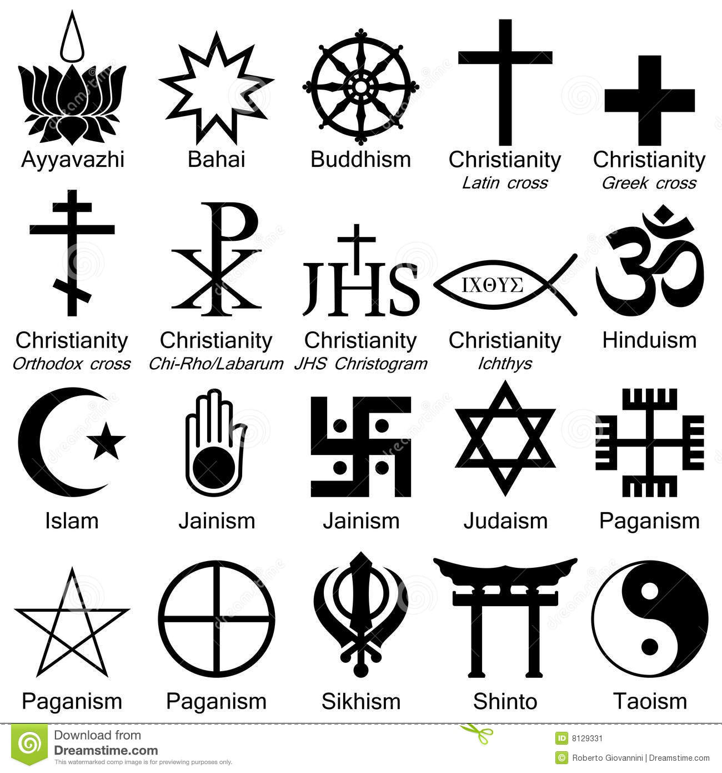
Living Religions

Slide 5
Spirituality
That dimension of our being – related to the physical and psychological dimensions – which gives our lives meaning and calls us towards our higher self, usually expressed in some form of relationship with a Divine Being (sometimes called God).

Slide 6
Examples
Aboriginal Spirituality
African Spirituality
Holism
Antagonism (science based)
Ietism (belief in an undetermined transcendent force)
Astrology
Yoga

Slide 7
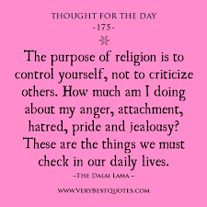
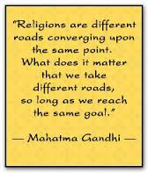
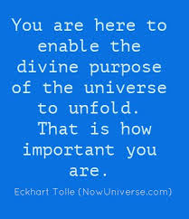
What is the purpose of religion?

Slide 8
Ritual
Is a behaviour which involves repeated actions. It links us with other people and supports the values on which we base our lives. Examples range from the laying of wreaths on Anzac Day to a simple handshake.

Slide 9
Rite of Passage
Are the sets of rituals that happen when people move from one stage of life to another, such as from unborn to born, child to adult, single to married and from alive to dead. Some examples include; funeral rites, baptisms, 18th or 21st birthday parties.

Slide 10
Religious Images analysis

Slide 11
Religious Images analysis

Slide 12
Religious Images analysis

Slide 13
Key Aboriginal Spirituality Terms

Slide 14
The interconnectiveness of Aboriginal Spirituality

Slide 15
Video Clips
https://www.youtube.com/watch?v=hOWzcLuupi0
https://www.youtube.com/watch?v=fHLEGVnLccM

