Slide 1
Euthanasia
Courage Faith Discussion 2012

Slide 2
What is euthanasia?
“the act or practice of killing or permitting the death of hopelessly sick or injured individuals (as persons or domestic animals) in a relatively painless way for reasons of mercy”
Merriam Webster Dictionary
“the act of killing someone painlessly (especially someone suffering from an incurable illness)”
Princeton University Wordnetweb

Slide 3
Myth 1: It allows people to die with dignity
People do not lose their dignity as death approaches.
Our dignity (value as a human person) does not depend on quality of life.
Dying with dignity?
Showing a gratitude and reverence of gift of life

Slide 4
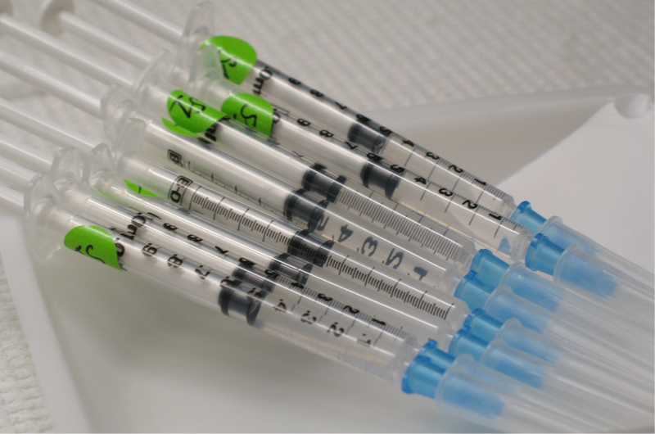
Myth 2: It is a compassionate response
Do all we can to eliminate the suffering but not the sufferer.
Compassion: to suffer alongside.
“True compassion leads to sharing another’s pain; it does not kill the person whose suffering we cannot bear” Blessed JPII

Slide 5
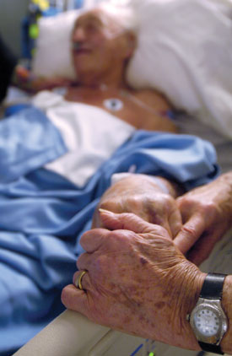
Myth 3: It is a personal choice
Euthanasia is a public act with public consequences.
Could lead to abuse, exploitation and erosion of care of the vulnerable.
Public witness to the idea of ‘a life not worth living’
Choice to die may become duty to die.

Slide 6
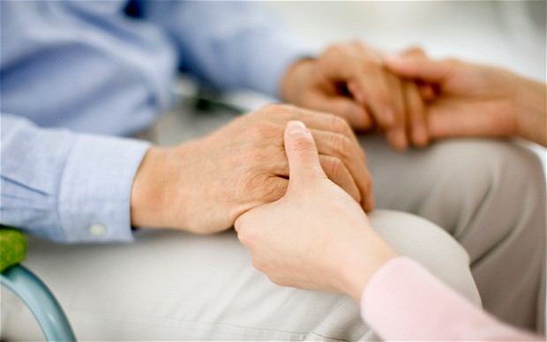
Myth 4: It can be closely regulated to avoid abuse
Overseas experience confirms reality of a ‘slippery slope’ from voluntary euthanasia to involuntary euthanasia.
Netherlands example:
Intended for adults
Now includes the unconscious, disabled babies, children, people with psychiatric illnesses and dementia

Slide 7
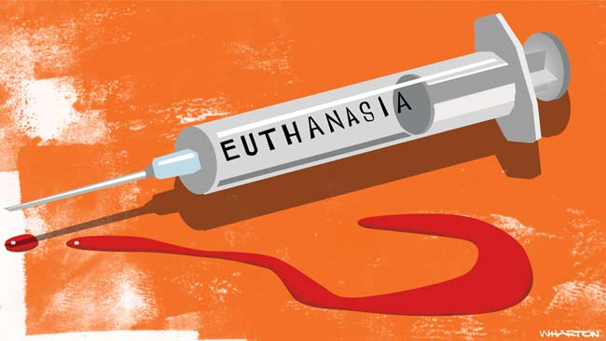
Myth 5: Legalised euthanasia would not impact upon the provision of good end of life care
Palliative care cannot flourish alongside euthanasia.
Killing discourages research and gains in alternative approaches in suffering.
Especially likely in an ageing country like Australia with large health care costs in the future.

Slide 8
