Slide 1
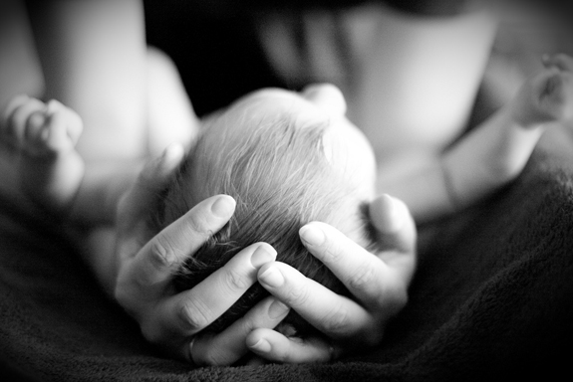
Pro-life What’s all the fuss?
Courage Faith Discussion Program
Mary MacKillop College, Wakeley

Slide 2
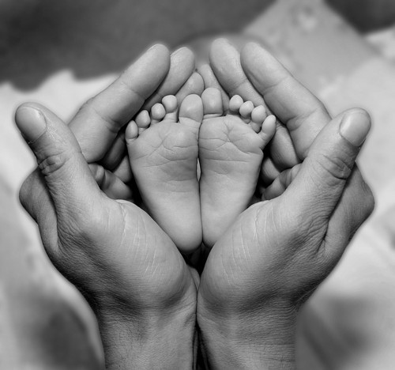
What is all about?
For decades there has been fierce debate over the issue of abortion.
In recent times, this debate has become quite vocal and is gaining much moment on the side of pro-choice.
The Catholic Church has played a prominent role in the pro-life movement.
This is known as the pro-life vs. “pro choice” debate.

Slide 3
The range of issues

Slide 4
The range of issues
Today’s focus

Slide 5
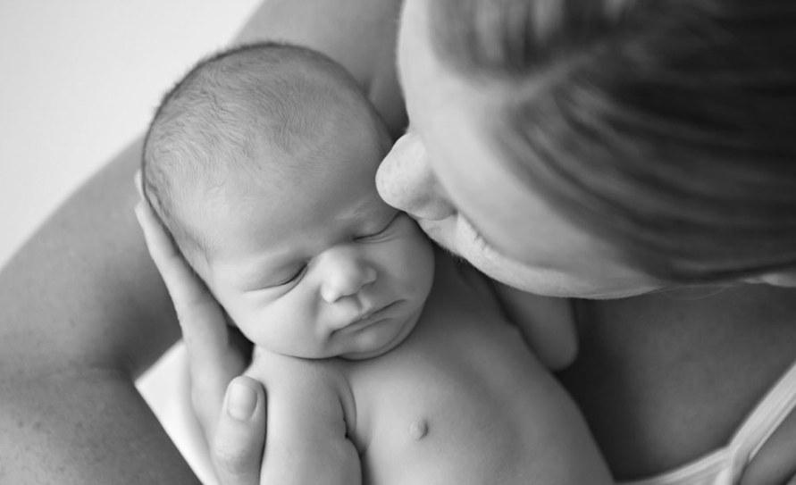
What is an abortion?
It is the termination of a pregnancy by a procedure that empties the contents of the uterus.
Most commonly done using surgical procedures between 7-12 weeks of pregnancy.

Slide 6
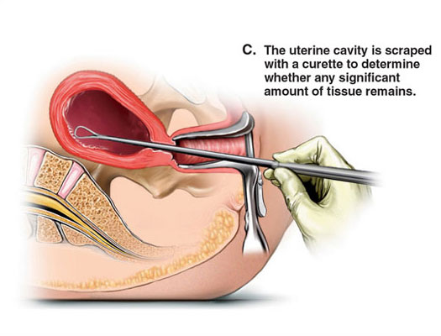
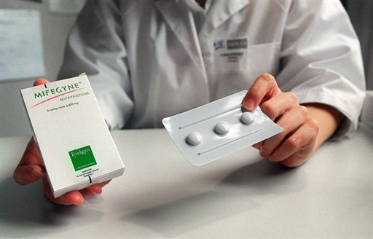
Types of abortions
Surgical abortion
Medication abortions
Second trimester abortion

Slide 8
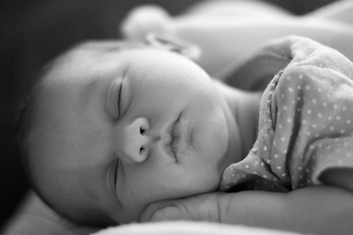
Abortion in Australia
How many babies were born in Australia during 2009?
291,227 babies
How many babies were aborted in 2009?
76,546
Statistics sourced from Medicare and does not take into account unreported abortions/non-Medicare funded abortions.

Slide 9
26%

Slide 10
To put that into context that would be 231 students at Mary MacKillop College

Slide 11
Thought that seemed bad?

Slide 12
Abortion in Australia
How many babies were born in Australia during 2009 for woman aged between 15-19?
12,120 babies
How many babies were aborted in 2009 for woman aged between 15-19?
10,023 babies
Statistics sourced from Medicare and does not take into account unreported abortions/non-Medicare funded abortions.

Slide 13
84%

Slide 14
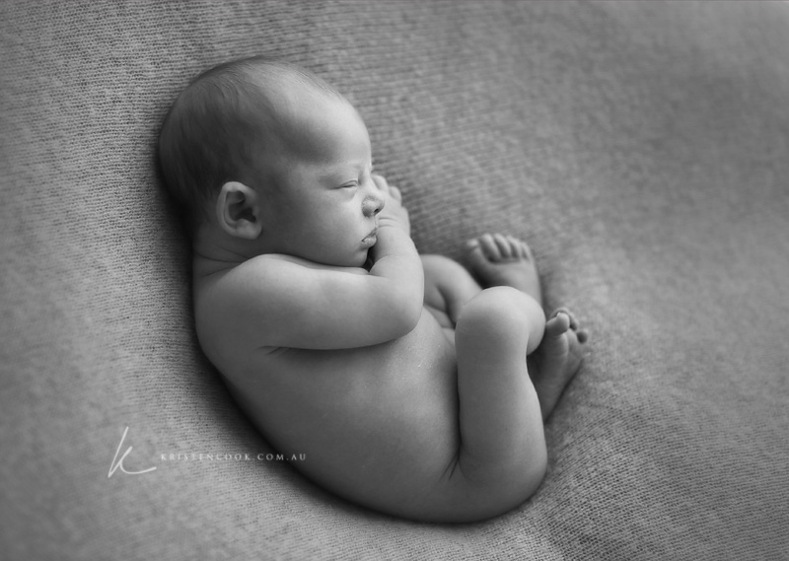
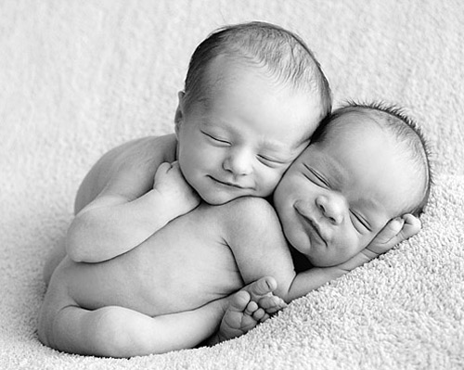
What does the Church say?
Life as a gift from God the Creator
The protection of all life, which is sacred
Sex without consequences
Link to contraception and the culture that it is creating
Forbids abortion just as it forbids murder
Abortion is forgivable as like all other sins
“Before I formed you in the womb I knew you, and before you were born I consecrated you…” Jeremiah 1:5

Slide 15
Blessed John Paul II
“It is necessary to become courageously ‘pro-woman’ promoting a choice that is truly in favour of women. It is precisely the woman… who pays the highest price, not only for motherhood but even more for its destruction, for the suppression of the life of the child who has been conceived. The only honest stance, in these cases, is that of radical solidarity with the woman. It is not right to leave her alone.”

Slide 16
Mother Chooses Life
http://www.lifesitenews.com/news/video-of-mom-who-refused-abortion-for-disabled-son-approaches-staggering-10

Slide 17
Questions

