Slide 1
Personal Moral Responsibility
Abortion

Slide 2
Abortion in Australia
Abortion is not uncommon for young women in Australia; about 30% of women become pregnant in their teenage years (usually their late teenage years), and about 50% of those have abortions.
Despite this, many young women may not know their rights and options regarding abortion, therefore may be reluctant to seek the help they need.

Slide 3
The Abortion Law Act
While the laws on abortions are strict about consent and availability, in practice it is not difficult for young women to have abortions, with or without parental consent. Abortion is provided at no cost by the in some centres for up to 22 weeks into the pregnancy.
Some centres also provide confidential treatment for girls under 16, and has counsellors available to discuss options with patients, and any fears or issues they may have.

Slide 4
Issues:
The girl may be pressured by her parents to do what they think is right.
Given the short amount of time a girl has to make the decision to terminate a pregnancy, she may not be able to access all of the information she needs to make a fully informed choice.

Slide 5
Issues:
The father may not want to be a part of the child’s life, or may not want the girl to have an abortion – this might influence the girl’s decision to terminate the pregnancy.
Pregnancy also affects young men – while he has no right to stop the young girl from terminating the pregnancy, he may also require counselling and support.
This is not generally considered important, therefore young men may not know where they can turn for help.

Slide 6
Issues:
Counselling is not compulsory for abortions – young girls may not take the option and will not have the opportunity to discuss their issues and concerns.
Negative social attitudes towards abortion may influence the girl’s decision, or make her reluctant to seek help.

Slide 7
Questions:
􀃆 Does the father have a right to know if the pregnancy is terminated?
􀃆 Can a minor be sure that her parents won’t find out if she has an abortion?
􀃆 What rights do the parents of a minor have in relation to termination of pregnancy?
􀃆 If a parent suspects their daughter is having/has had an abortion, is there any way they can find out?

Slide 8
Questions:
􀃆 What can a parent do to help their daughter through this difficult time?
􀃆 What if the parents refuse to consent to an abortion?
􀃆 What if parents are encouraging an abortion but the girl wants to keep the baby?
􀃆 What are the physical and emotional risks of abortion?

Slide 9
Questions:
􀃆 Who can a young woman talk to if she needs help making a decision?
􀃆 Who can a young man talk to if he has issues concerning the abortion or pregnancy?

Slide 10
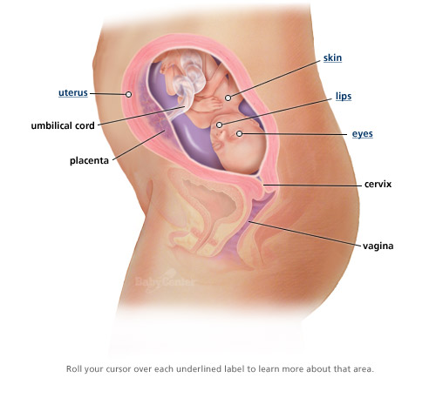
What your baby looks like -- 22 weeks
http://www.babycenter.com/fetal-development-images-22-weeks

